Slide 1

Bay 1, Stage 1 Copy Paste Course Designer: Jordan Rogers
Copy Paste is a 30 round, 150 point Comstock long course. There are 14 IPSC targets and 2 steel targets. The best two hits per target will score. Steel must fall to score. The start signal is audible.
The Handgun start position is loaded and holstered, hands touching the upper pair of marks on the up-range wall. The PCC start position is loaded with muzzle touching the lower mark on the up-range wall.
On the audible start signal, engage all targets as visible from within the shooting area. PP2 activates the max trap, which remains visible at rest All barrels are soft cover.

Slide 2
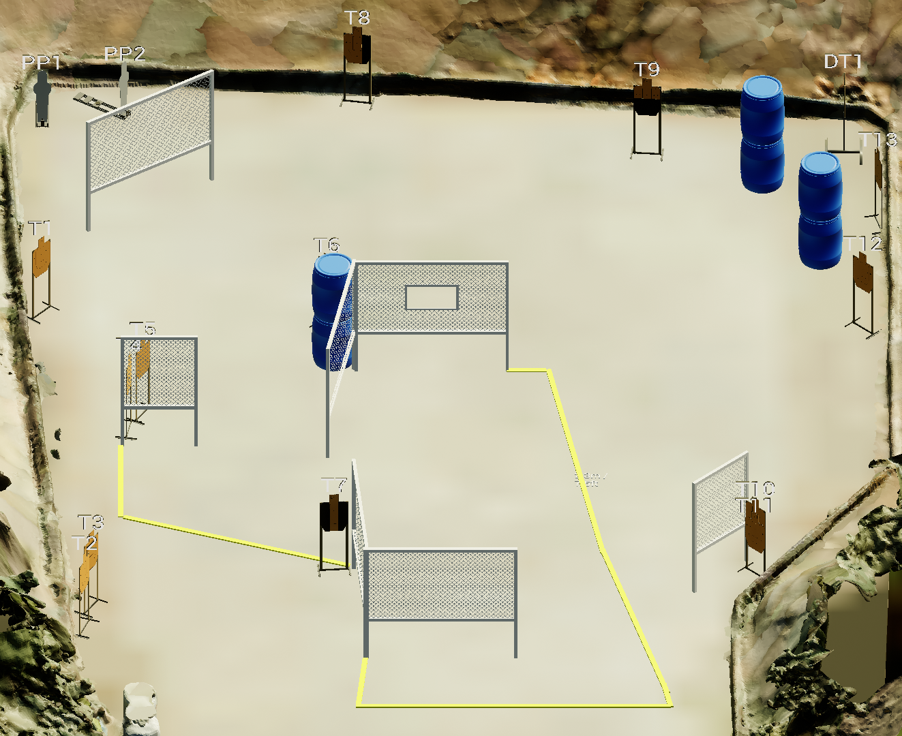
 | Stage 1 Copy Paste Course Designer: Jordan Rogers
xx
x

